Slide 1
The Byzantine Empire: Were the Dark Ages really dark?
310 CE to 1000 CE
(very approximately)

Slide 2
Dark Ages or Middle Ages?
Dark Ages
Middle Ages
Gibbon’s book The Decline and Fall of the Roman Empire (1788) set the biased tone
Roman/Greek civilization was best
Barbarians were forces of darkness
No culture or unified society in Europe
Newer understanding
Medium Aevium – Latin for “middle age”
Seen as a time of change rather than decline
Society is fragmented – local cultures flourish

Slide 3
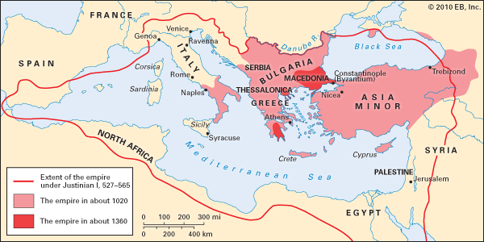
The Byzantine Empire

Slide 4
Legacy of Rome
Language, laws, culture spread rapidly after Roman rule
Roman model of government
Military governors, bureaucracy
Imperial army (mercenaries)
Taxes and monoplies

Slide 5
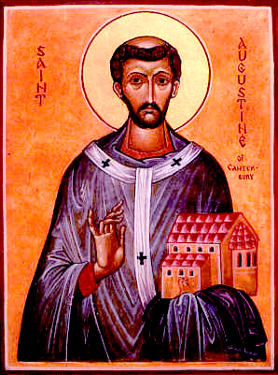
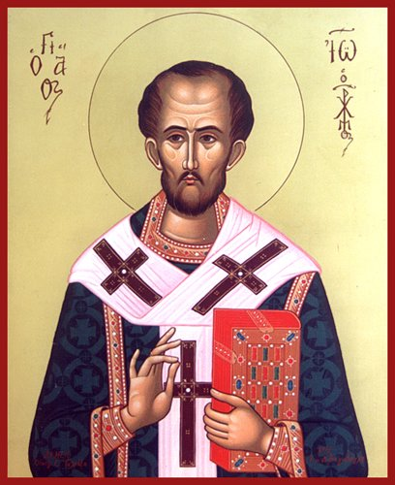
The Church in Control
West –
Roman Catholic
East –
Greek Orthodox
Pope (means father)
Bishops of Rome
Independent of military
Patriarch (means father)
Bishops of Constantinople
Under firm control of Emperor of Byzantium
Pope Gregory of Rome
(540-604)
St. John Chrysostom, Patriarch of Constantinople
(344-404)

Slide 6
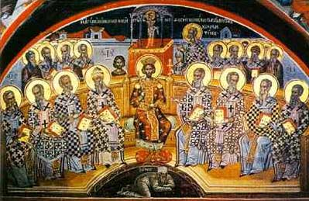
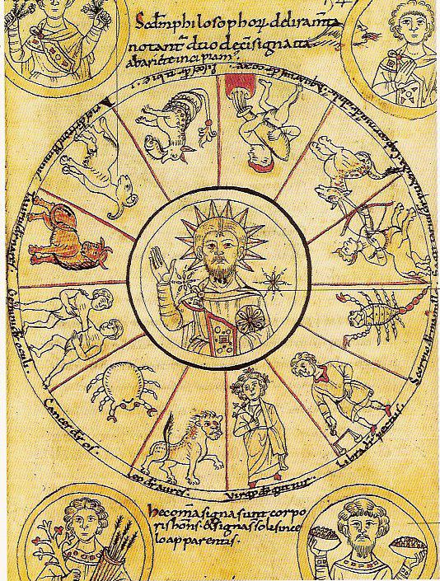
Heresy and Heretics
Heresy
Holding beliefs that contradict the official religion
Established with the Nicene Creed (325)
11th century zodiac

Slide 7
Nicene Creed
I believe in one God, the Father Almighty, Maker of heaven and earth, and of all things visible and invisible.
And in one Lord Jesus Christ, the only-begotten Son of God, begotten of the Father before all worlds; God of God, Light of Light, very God of very God; begotten, not made, being of one substance with the Father, by whom all things were made.
Who, for us men for our salvation, came down from heaven, and was incarnate by the Holy Spirit of the virgin Mary, and was made man; and was crucified also for us under Pontius Pilate; He suffered and was buried; and the third day He rose again, according to the Scriptures; and ascended into heaven, and sits on the right hand of the Father; and He shall come again, with glory, to judge the quick and the dead; whose kingdom shall have no end.
And I believe in the Holy Ghost, the Lord and Giver of Life; who proceeds from the Father [and the Son]; who with the Father and the Son together is worshipped and glorified; who spoke by the prophets.
And I believe one holy catholic and apostolic Church. I acknowledge one baptism for the remission of sins; and I look for the resurrection of the dead, and the life of the world to come. Amen.

Slide 8
Emperor Theodosius on Heresy (380)
We command that those persons who follow this rule [belief in the single Deity of the Father, the Son, and the Holy Spirit] shall embrace the name of Catholic Christians. The rest, however, whom we adjudge demented and insane, shall sustain the infamy of heretical dogmas… and they shall be smitten first by divine vengeance and secondly by the retribution of Our own initiative, which We shall assume in accordance with the divine judgment.

Slide 9
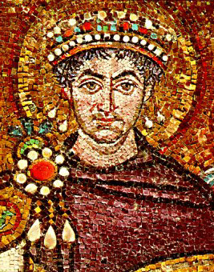
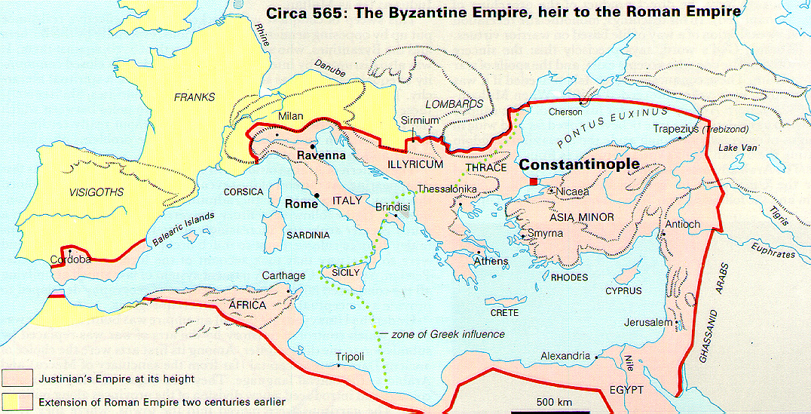
Justinian the Great (ruled 527-565)
Unity through Christianity
Unity through Conquest
Suppressed all heretics including
Monophysites: Christ has a single divine nature (not human)
Arians: Christ and Holy Spirit are secondary gods, mediating between Father and world (not the Trinity)
Recaptured Rome in 554

Slide 10
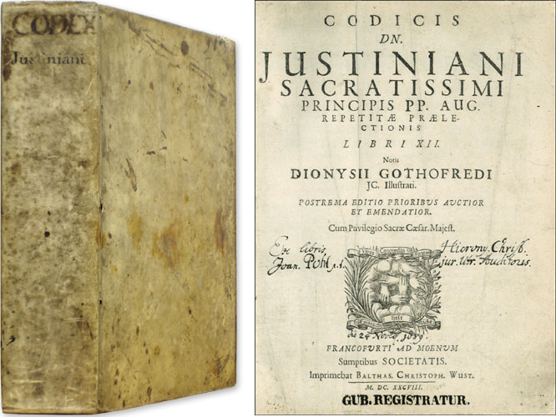
Justinian Code
Codified all Roman laws in the Justinian Code or “Body of Civil Law”
Defined: property people could own, how property was passed to heirs, resolving disputes
Basis of all law today

Slide 11
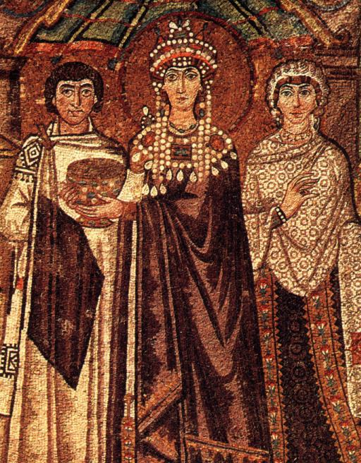
Empress Theodora
Appropriate?
Plebeian, not Patrician
Former actress
Justinian had law changed so he could marry her
Monophysite
Never gave up her beliefs
Legal Changes
Prevent sale of girls
Reformed divorce laws to protect women

Slide 12
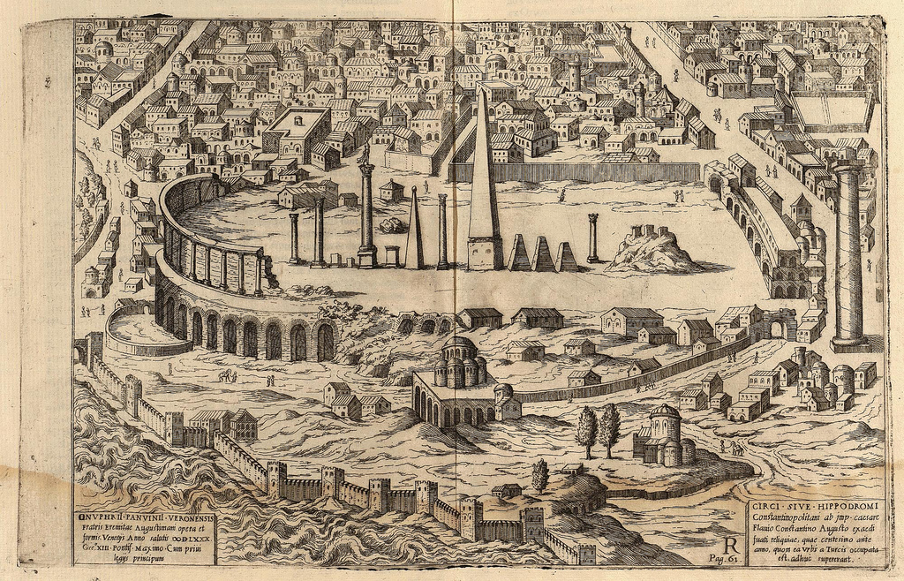
Nika Riots
“Nika” = victory
Anger turns into rebellion
Rebels proclaim new emperor
Set city on fire
Theodora’s speech
Justinian kills rebels in the Hippodrome
“The Purple makes a fine winding sheet.”
- Empress Theodora

Slide 13
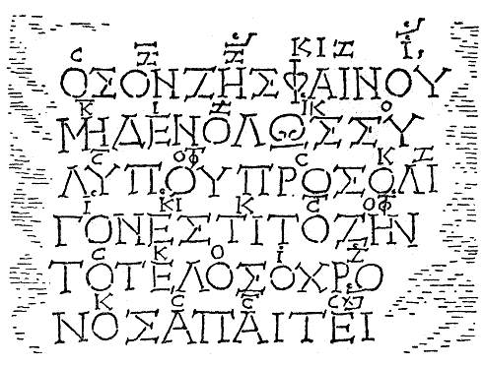
Greek Language
After Justinian (565 CE)
Greek becomes common language of Byzantium
Latin used in western empire
Another end of the Roman Empire
Song of Seikilos
Found in Byzantium, c.100 CE
Be, as long as you live, a sunshine, do not be sad.
Cause life is surely short, and time demands its toll.

Slide 14
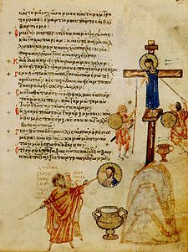
Iconoclast Controversy
Iconoclasts = image destroyers
730 CE
Emperor bars icons
Persecutes worshippers
Destroys 700 years of art
787 CE
Images re-established
815 CE
Images banned again
843 CE
Icons restored for good
Page from the iconoclastic psalter, 9th century

